Slide 1
Digital solution for Artisan Market Expansion
PIP2001 Capstone Project
VIVA VOCE
Batch Number: CSE-154 PSCS-193
Under the Supervision of,
Ms. Shweta Singh
Assistant Professor
School of Computer Science and Engineering
Presidency University
Roll Number | Student Name
20211CSE0546 | SHARAT
20211CSE0563 | FAREEDAHMED
20211CSE0572 | V S KRISHNA CHAITANYA AVVARI
Name of the Program: CSE
Name of the HoD: Dr. Asif Mohammed H.B
Name of the Program Project Coordinator: Mr. Amarnath J.L & Dr. Jayanthi. K.
Name of the School Project Coordinators: Dr. Sampath A K / Dr. Abdul Khadar A / Mr. Md Ziaur Rahman

Slide 2
Introduction
Cultural Heritage: India has a rich cultural heritage, particularly in art and crafts.
Opportunities for Artists: The cultural diversity creates numerous opportunities for local artists to showcase and sell their work.
Technological Adoption: Increasing reliance on technology for daily needs, including shopping.
E-commerce Trend: Growing use of E-commerce websites for purchasing a variety of products like
clothes, groceries, and electronics.
Project Overview: Development of an E-commerce web application using MERN stack technology.
User and Admin Views: The application will feature different views for users and administrators.
Payment Integration: Integration with a payment gateway for seamless checkout.
Target Audience: The platform, named Epicraft, aims to support creative entrepreneurs in the
handloom and handicraft sector.

Slide 3
Literature Review
E-commerce Platforms for Artisans:
Existing Platforms: Look into global platforms like Etsy, Amazon Handmade, or even smaller, local initiatives like Craftsvilla or Jaypore that focus on selling handicrafts and rural products.
How do these platforms manage artisan profiles?
What kinds of user experiences do they offer for both sellers (artisans) and buyers?
How do they handle logistics, product rankings, and payments?
• Insights: These platforms offer global visibility but are often too complex for rural artisans. Your project could focus on simplifying the user experience by creating a platform specifically tailored to artisan needs, keeping technology use minimal

Slide 4
Existing method Drawback
1.Lack of space -It becomes a problem in itself to find space to keep the sheets of paper being generated as a result of the ongoing discussion. The documents being generated are too important to be ill-treated.
2. Filing poses a problem - Sorting out the documents categorically is a time consuming and tedious exercise .
3. Filtering is not easy - It becomes hard to filter relevant products for the irrelevant ones if the count of the same crosses a certain manageable number.
4. Result Processing - is slow due to paperwork and requirement of staff

Slide 5
Proposed Method
E-Commerce Web Application Proposal: Epicraft
Technology Stack: Built using MERN (MongoDB, Express.js, React.js, Node.js).
Functionality:
Fully functional website with distinct user and admin options.
Payment gateway integration via Stripe for secure checkout.
Product Management:
Admin features: create, manage, and delete products and categories.
User features: browse and add items to the cart for easy purchasing.
User Experience:
Quick cart addition and automatic bill generation.
Easy registration and login process for users.

Slide 6
Proposed Method
5.Modules Overview:
Coding and backend development.
UI design using React context.
Seller and customer management.
Delivery and payment management.
6.Mission: To enhance Indian handloom and handicraft exports by connecting artists with customers.
7.Job Opportunities: Artists can apply for various crafts jobs posted by administrators.
8.Convenience: Saves time by offering a variety of products in one place, accessible via laptops or mobiles.

Slide 7
Objectives
Empower Local Artisans: Provide a platform for underprivileged artists to showcase and
sell their handloom and handicraft products online, thus creating job opportunities.
Develop a User-Friendly Interface: Create an intuitive and engaging website design that
enhances the shopping experience for users.
Implement MERN Stack Technologies: Utilize the MERN stack to build a robust and
scalable web application, ensuring efficient performance and data management.
Facilitate Secure Transactions: Integrate a reliable payment gateway (e.g., Stripe) to
ensure secure and seamless payment processes for users.
Enable Efficient Product Management: Develop administrative functionalities that allow
easy management of products, categories, and inventory.
.

Slide 8
Objectives
Incorporate Interactive Features: Implement features like a shopping cart, user registration, and product filtering to enhance user engagement.
Promote Cultural Heritage: Help preserve and promote Indian handloom and handicraft traditions through increased visibility and access to these products.
Gather User Feedback: Create mechanisms to collect user feedback for continuous improvement of the platform.
Analyze User Behavior: Implement analytics tools to understand user preferences and shopping patterns for data-driven decision-making.
Foster Community Engagement: Build a community around artisans and customers to encourage collaboration and support within the crafts sector.

Slide 9
Methodology
Phase 1: Requirement Gathering :
Stakeholder Interviews: Engage with artisans and potential buyers to understand their needs, preferences, and pain points. Ensure that the platform’s features align with their expectations.
Competitive Analysis: Conduct research on similar platforms (as covered in the literature survey) to identify what works well and what can be improved.
Phase 2: Platform Design - Frontend Technology:
Use a simple front-end framework like Vue.js or React.js to create a mobile-friendly, responsive UI for the website.
Design mock-ups should focus on user simplicity, easy navigation, and minimal steps for product uploads.

Slide 10
Methodology
Backend Technology :
Use Node.js with Express for the backend to handle user registrations, product uploads, and event creation.
Implement REST APIs for communication between the front and backend.
Database: Use MongoDB (or MySQL) for storing product details, sales statistics, user information, and event data.
Authentication: Use JWT tokens for secure authentication and authorization
Phase 3: Key Feature Implementation :
User Registration and Product Upload:
Develop a simple registration form with input fields for personal details and verification processes
Allow artisans to upload multiple images per product, set prices, and describe product details in an easy-to-use form.

Slide 11
Methodology
Phase 4: Testing & Iteration :
User Acceptance Testing (UAT): Test the platform with a small group of artisans and buyers, gathering feedback on usability and functionality.
Load Testing: Ensure the platform can handle multiple simultaneous users, especially during events or peak sales periods.
Security Testing: Test for vulnerabilities in the authentication system, particularly around COD and payment methods.
Phase 5: Launch and Monitoring :
Rollout: Launch the platform in phases, starting with a small group of artisans and gradually expanding.
Feedback Loop: Set up a feedback mechanism for continuous improvement. Use data from the platform (e.g., which features artisans use the most) to prioritize future updates

Slide 12
Hardware/software components
HARDWARE REQUIREMENTS:
CPU: 3.6GHz
RAM: 4GB
Memory: 10 GB (Minimum)
SOFTWARE REQUIREMENTS:
Languages:HTML5, CSS3, JavaScript
Database: MongoDB
Frameworks: Node.js

Slide 13
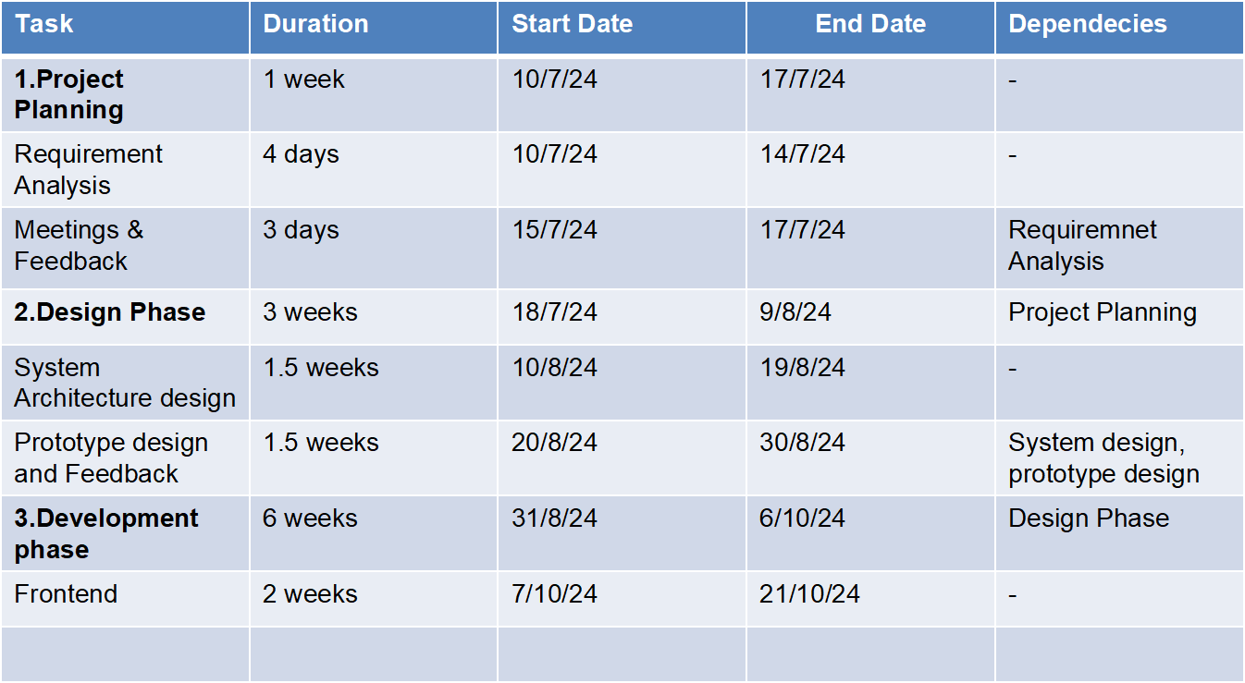
Timeline of Project
Backend | 2 weeks | 22/10/24 | 6/11/24 | Frontend
Database setup | 2 weeks | 7/11/24 | 21/11/24 | Backend

Slide 14
Expected Outcomes
Enhanced Visibility for Artisans: Increased exposure for local artists and craftsmen,
promoting their products to a wider audience.
User-Friendly Experience: A seamless and interactive user interface that simplifies
product browsing, election, and purchasing processes.
Efficient Product Management: Streamlined administrative functions for managing
products, categories, and inventory, leading to efficient operations.
Secure Transactions: Implementation of a reliable payment gateway (Stripe)
ensuring secure and smooth financial transactions for users.
Increased Sales: Improved sales for handloom and handicraft products due to better
accessibility and marketing through the platform.

Slide 15
Expected Outcomes
Community Building: Creation of a community for artisans and customers, fostering relationships and encouraging collaboration.
Job Opportunities for Artisans: Providing a platform for job listings related to crafts, enabling artists to find work and collaborate with others.
Data-Driven Insights: Gathering user data to analyze buying patterns and preferences, enabling targeted marketing and product development.
Scalability: A robust architecture allowing for future enhancements and scalability as the user base grows.
Cultural Preservation: Contributing to the preservation and promotion of Indian cultural heritage through the sale of traditional handloom and handicraft products.

Slide 16
Conclusion
Epicraft is an online handloom and handicraft portal which aims at giving employment to poor artists who are not able to sell their products online. This project helps in understanding the creation of an interactive website and the technologies used to implement it. The building of the project has given us precise knowledge about how MERN stack technology is used to develop a website, how it connects to the database to access the data and how the data and web pages are modified to provide the user with a shopping cart application.

Slide 17
Github Link
Github Link
https://github.com/SHARAT20211CSE0546/backend

Slide 18
References
https://www.researchgate.net/publication/32528 5588_ECOMMERCE_AND_RURAL_HANDICRAFT_A RTISANS M.Ushasri1 , N.Charitha2 , P.Chaitanya3 , G.Giridhar Sai 2016 International Conference on Microelectronics, Computing and Communications (MicroCom) (pp. 1-4). IEEE.
https://www.sih.gov.in/sih2022PS?technology_bu cket= NQ==&category=U29mdHdhcmU=&organization= QWxs&o rganization_type=QWxs
https://hwavaranasi.in/
https://handlooms.nic.in/assets/img/e-book/E-book.pdf

Slide 19
References
"The Art of Indian Handicrafts: A Comprehensive Guide" by Lata K. Chatterjee
"Rural Development and the Artisan Economy: A Study in Varanasi" by Anil S. Jha
"Crafting a Future: The Role of Handicrafts in Sustainable Development" by Samantha L. Green
“A Global Perspective on Craft Entrepreneurship" by Priya T. Sharma

Slide 20
References
"The Fabric of Our Lives: An Exploration of Textiles in the World" by Doris M. H. T. M. Rook
"Artisans and Their Crafts: A Global Perspective" by Barbara A. D. R. Smith
"Handmade: A Scientist's Search for Meaning in a Throwaway World" by Peter M. D. B. Craft
"Textiles of India: From the Village to the World" by Ritu Kumar

Slide 21
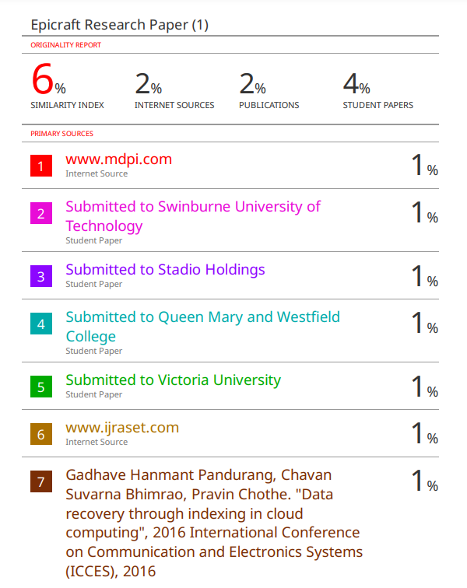
Similarity Check for Research Paper

Slide 22
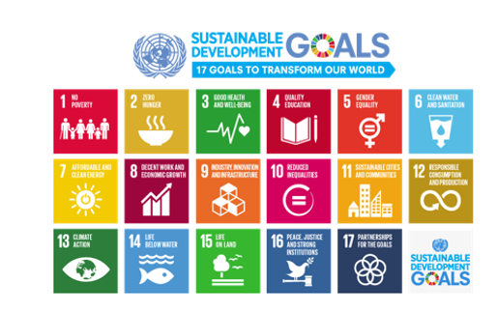
Project work mapping with SDG
SDG 9: Industry, innovation, and infrastructure: This goal aims to build resilient infrastructure, promote sustainable industrialization, and foster innovation. It includes targets such as developing reliable infrastructure, increasing access to financial services for small-scale businesses, and upgrading infrastructure to make it more sustainable.
SDG 12: Responsible consumption and production: This goal aims to promote responsible consumption and production.

Slide 23
Thank You

